Slide 1


Session no.19
Subject: Engineering Chemistry
Course Code: ETCH104
Program: B.Tech. CSE (Full Stack/IBM/DS) SEM-I
Faculty Name: Dr. Divyanshi Mangla
(Assistant Professor)
School of Basic and Applied Sciences

Slide 2

Table of Contents
Pre-requisite
Ni-Cd Batteries
Quiz
Support Material

Slide 3
Pre-requisite
Basic knowledge of Class 12th Chemistry
Electrode potential
Redox reactions
Batteries

Slide 4
Course Outcomes
CO1 | Understand the methods for water hardness and the basics of boiler water treatment and analyze fuel calorific values and battery. | BTL2
CO2 | Explain the characteristics and working principles of different battery types and types of fuels. | BTL2
CO3 | Determine the differences between batteries and fuel cells and classify fuel cell types based on their components. | BTL4
CO4 | Identify between hard and soft water, solve the related numerical problems on water purification and emf and its significance in industry and daily life. | BTL3

Slide 5
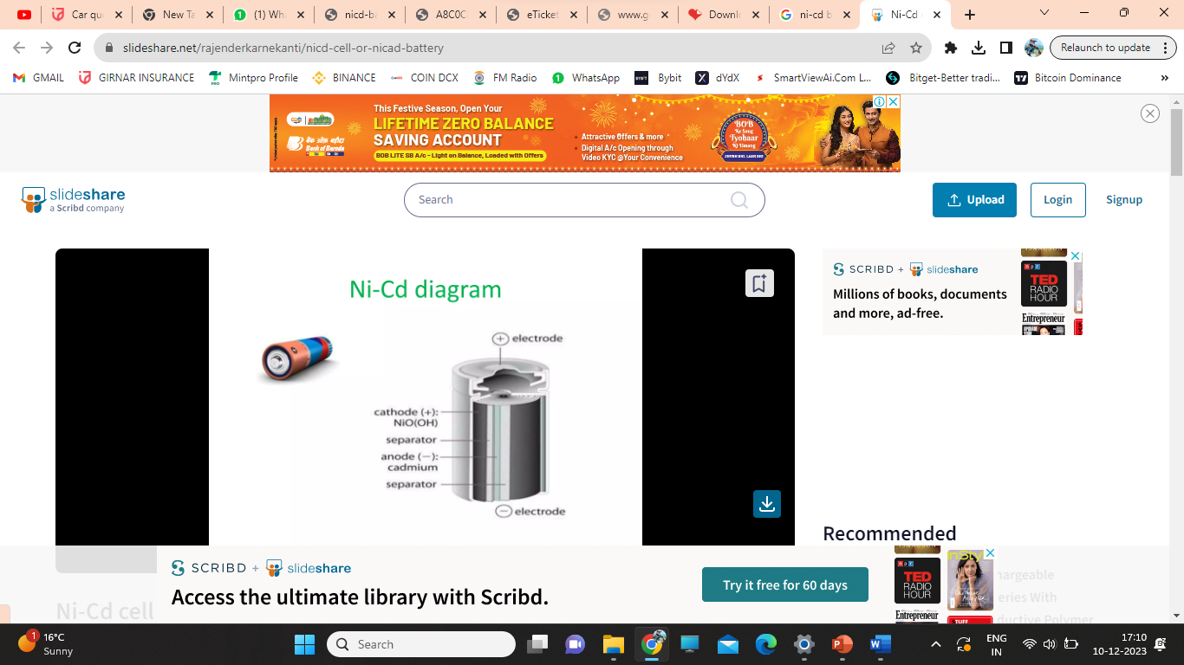
Nickel- Cadmium batteries
Anode: Cadmium (Cd) Electrolyte
Cathode: NiO2
Electrolyte: 30% KOH in distilled water
Fig 5 : Nickel- Cadmium battery

Slide 6

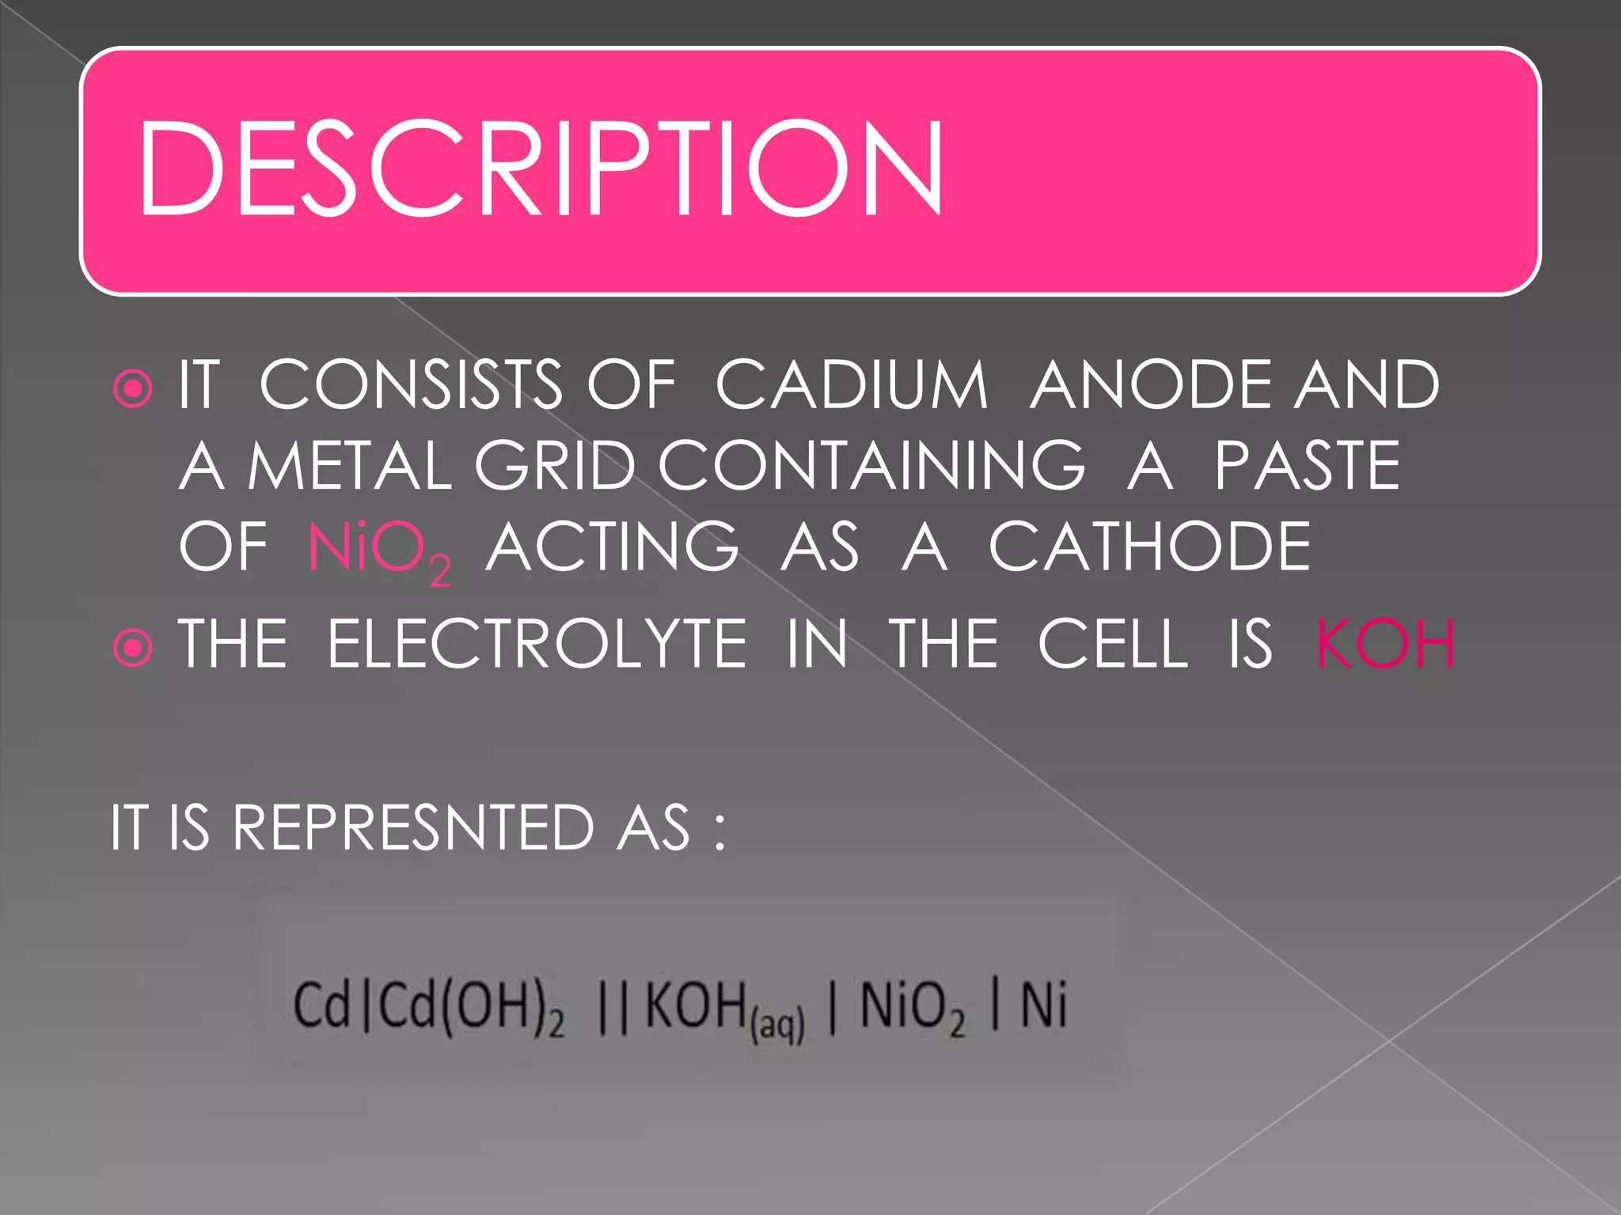

Slide 7
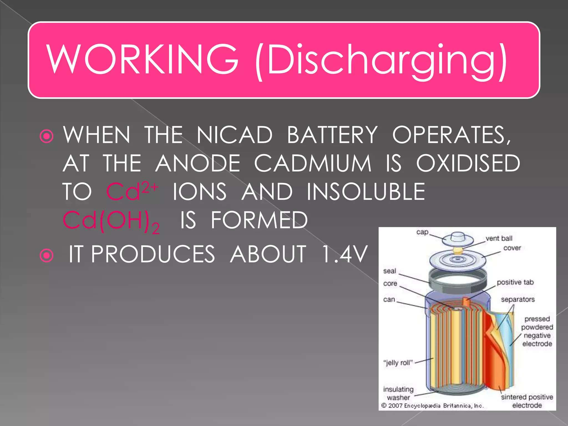

Slide 8
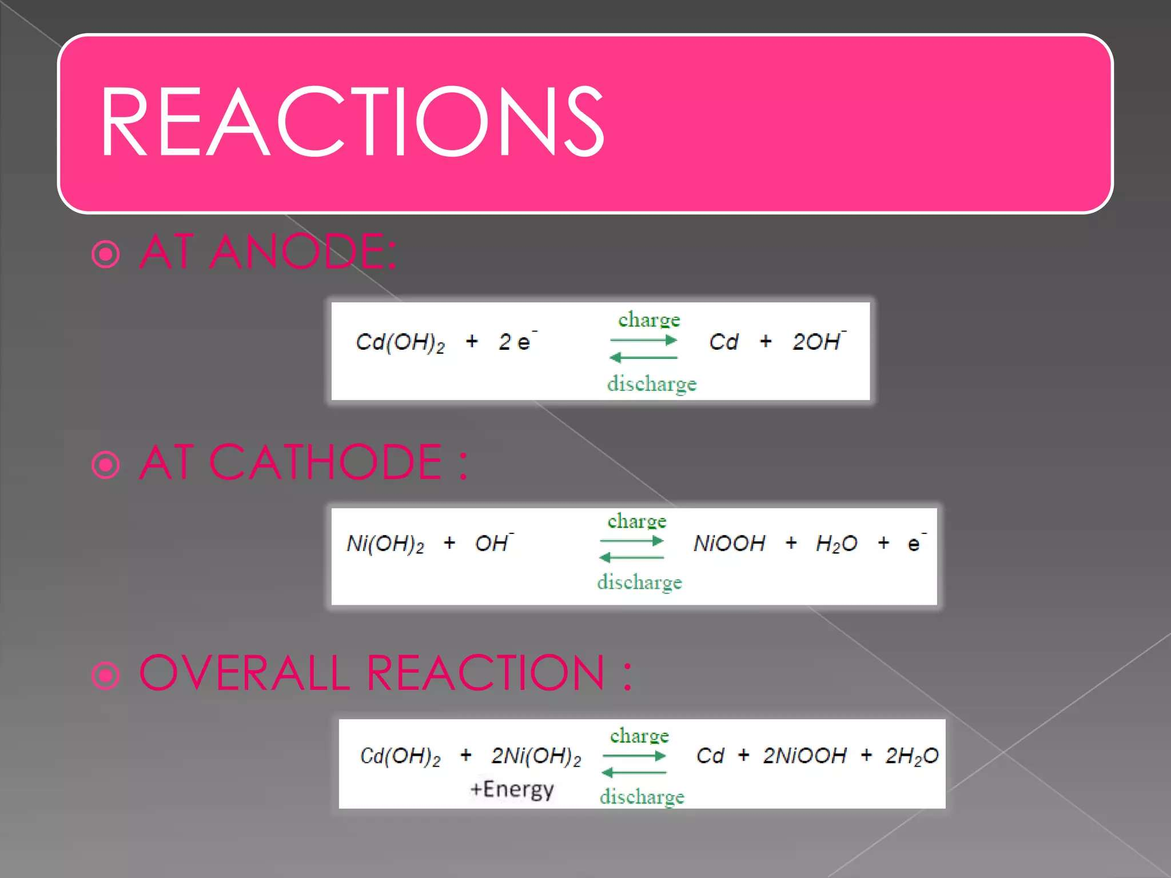

Slide 9
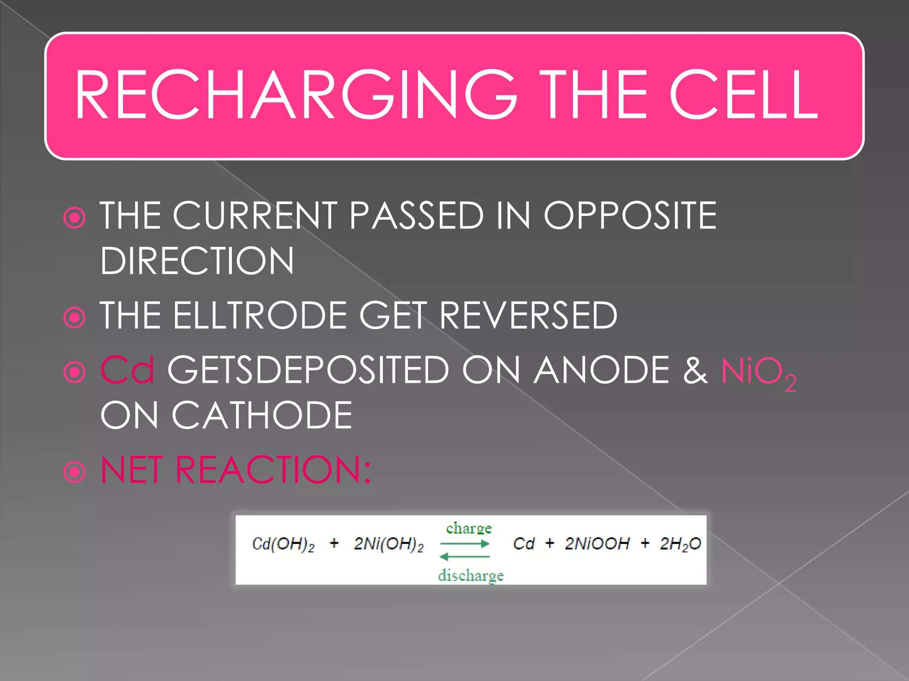

Slide 10
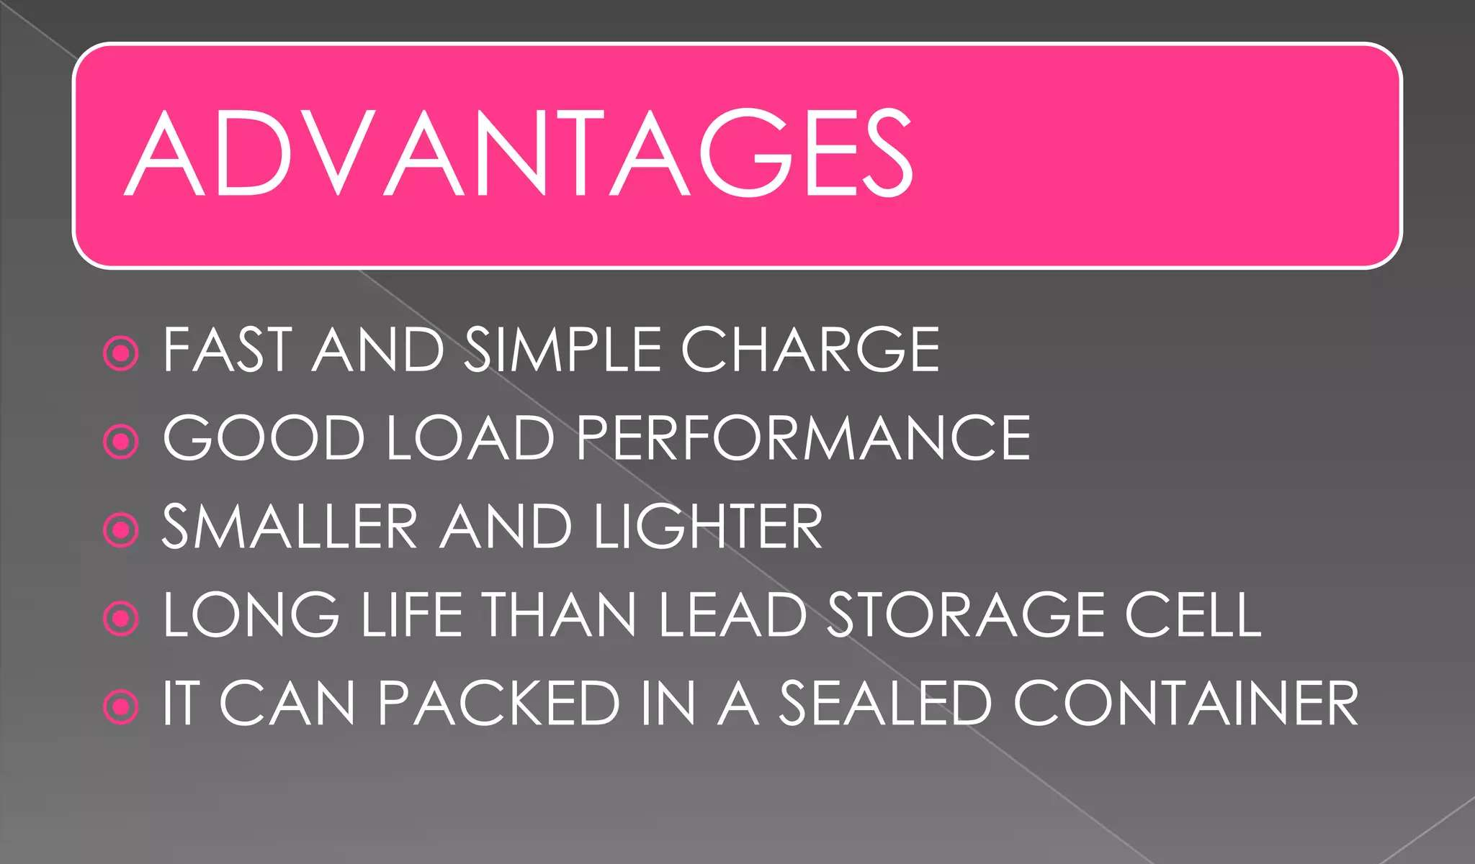

Slide 11
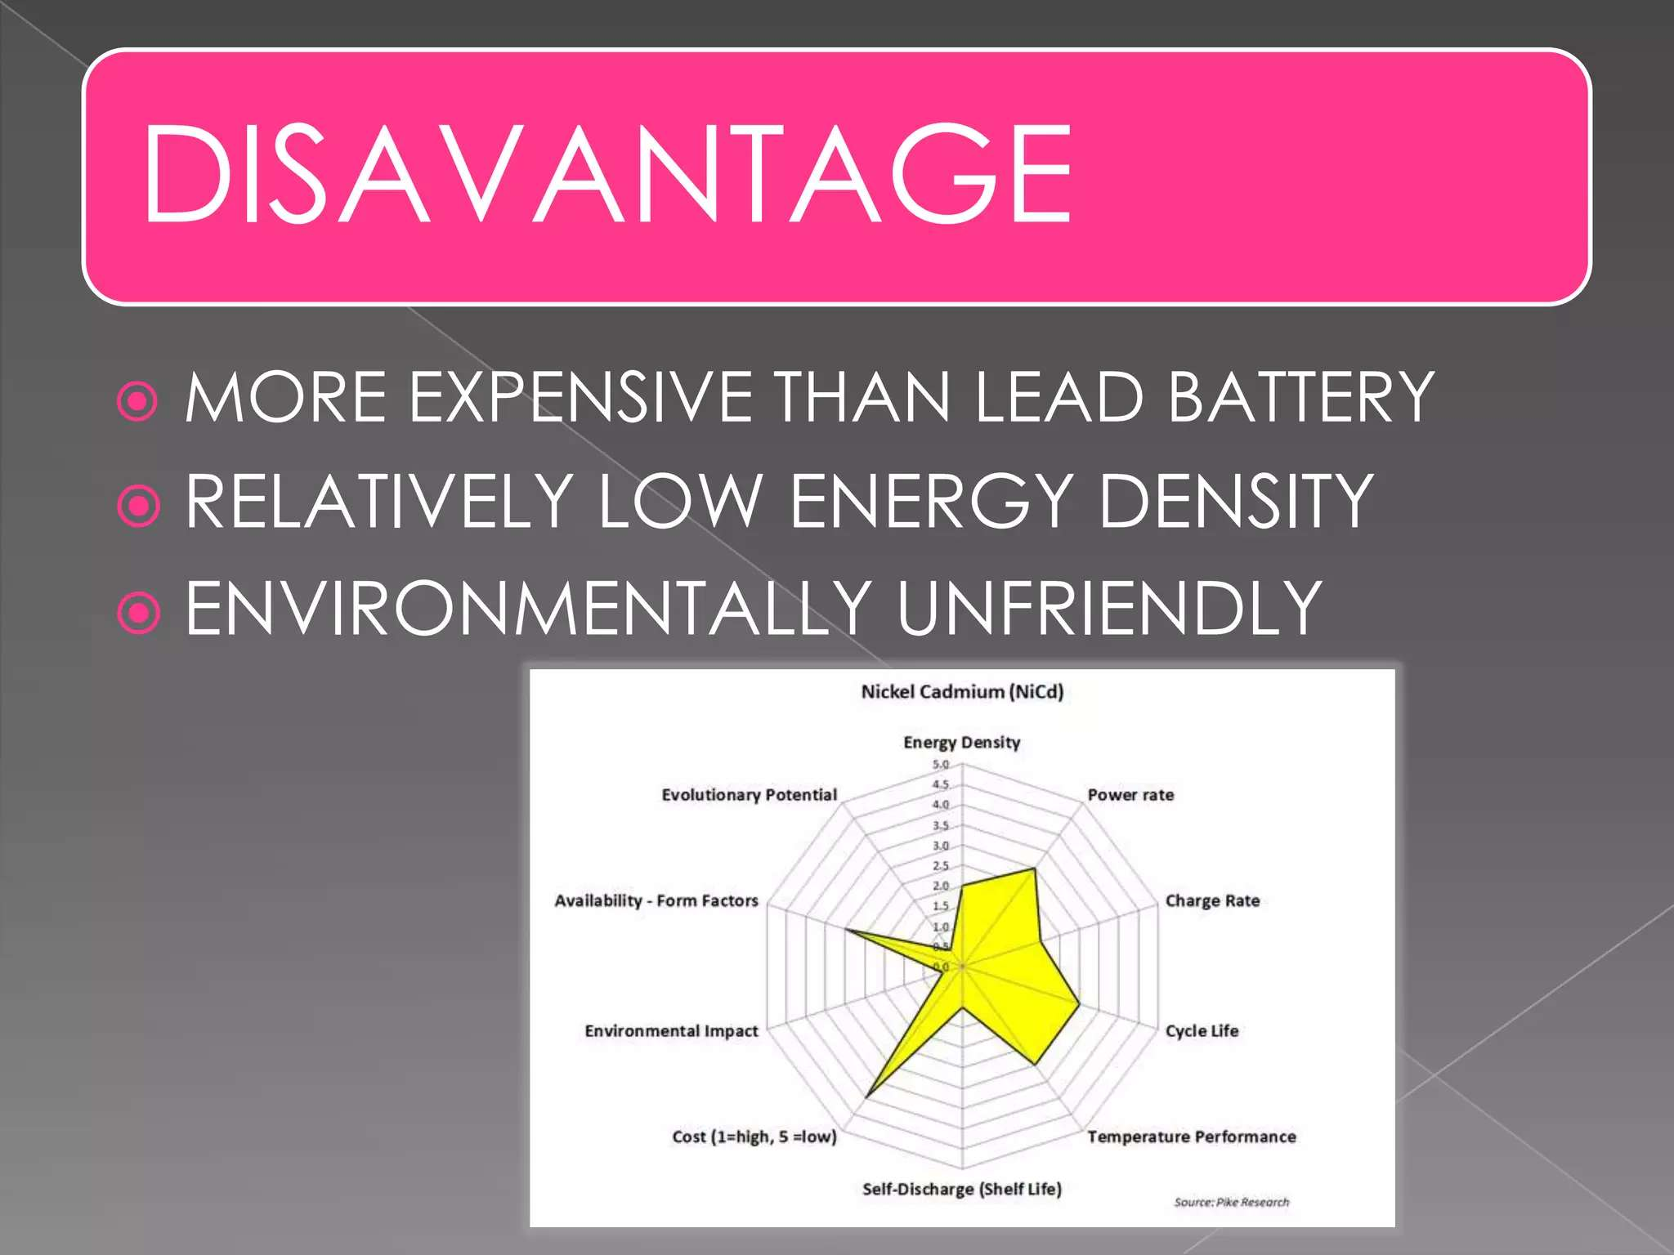

Slide 12
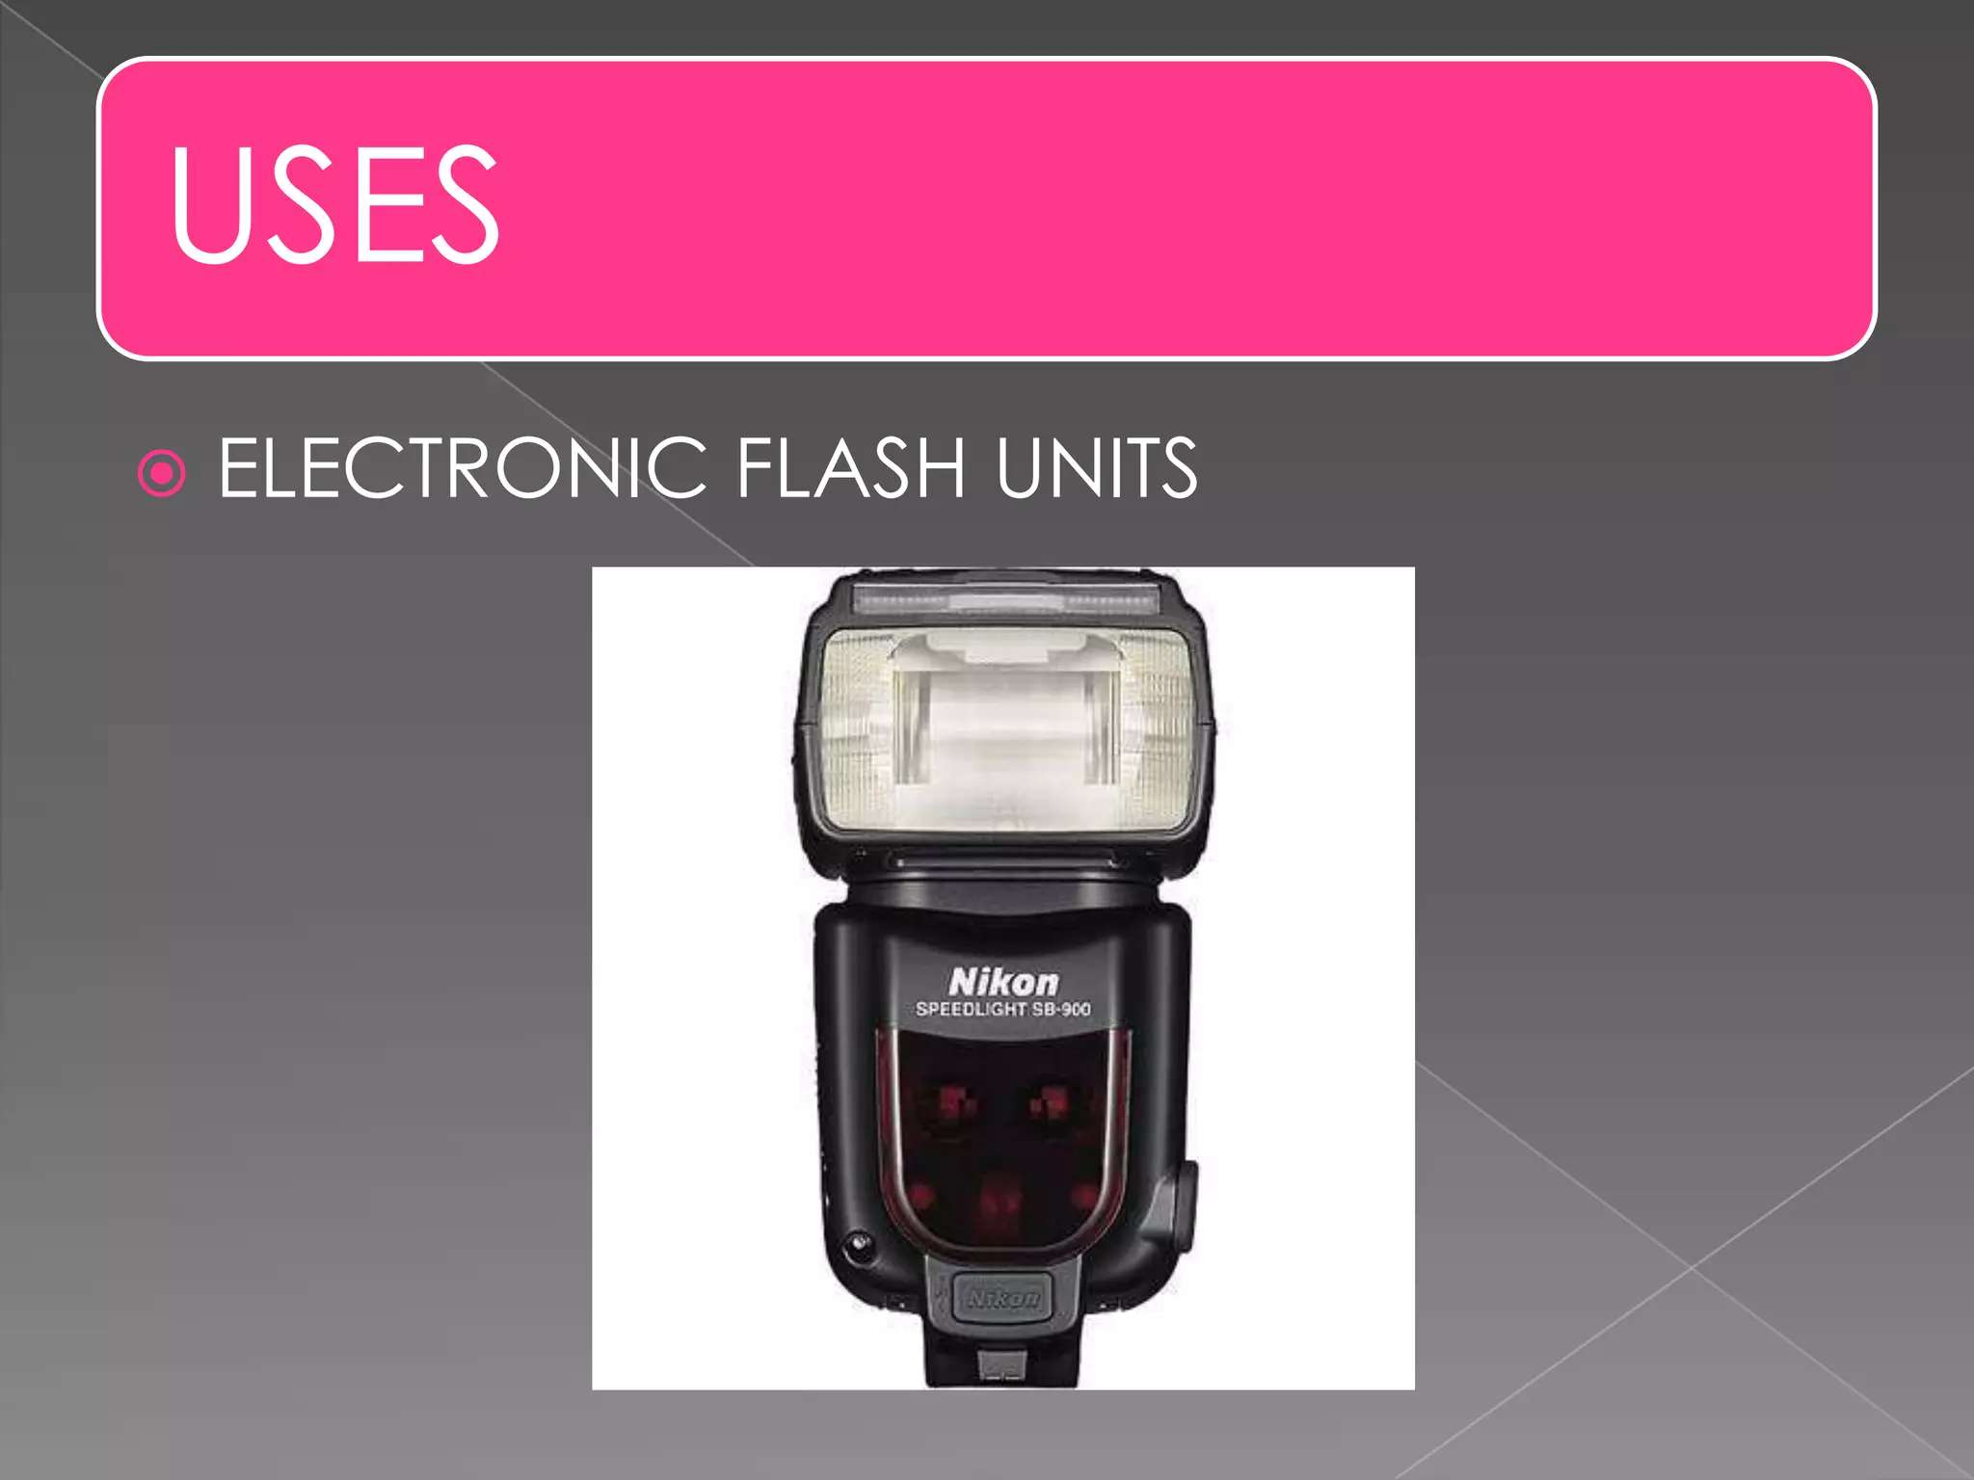

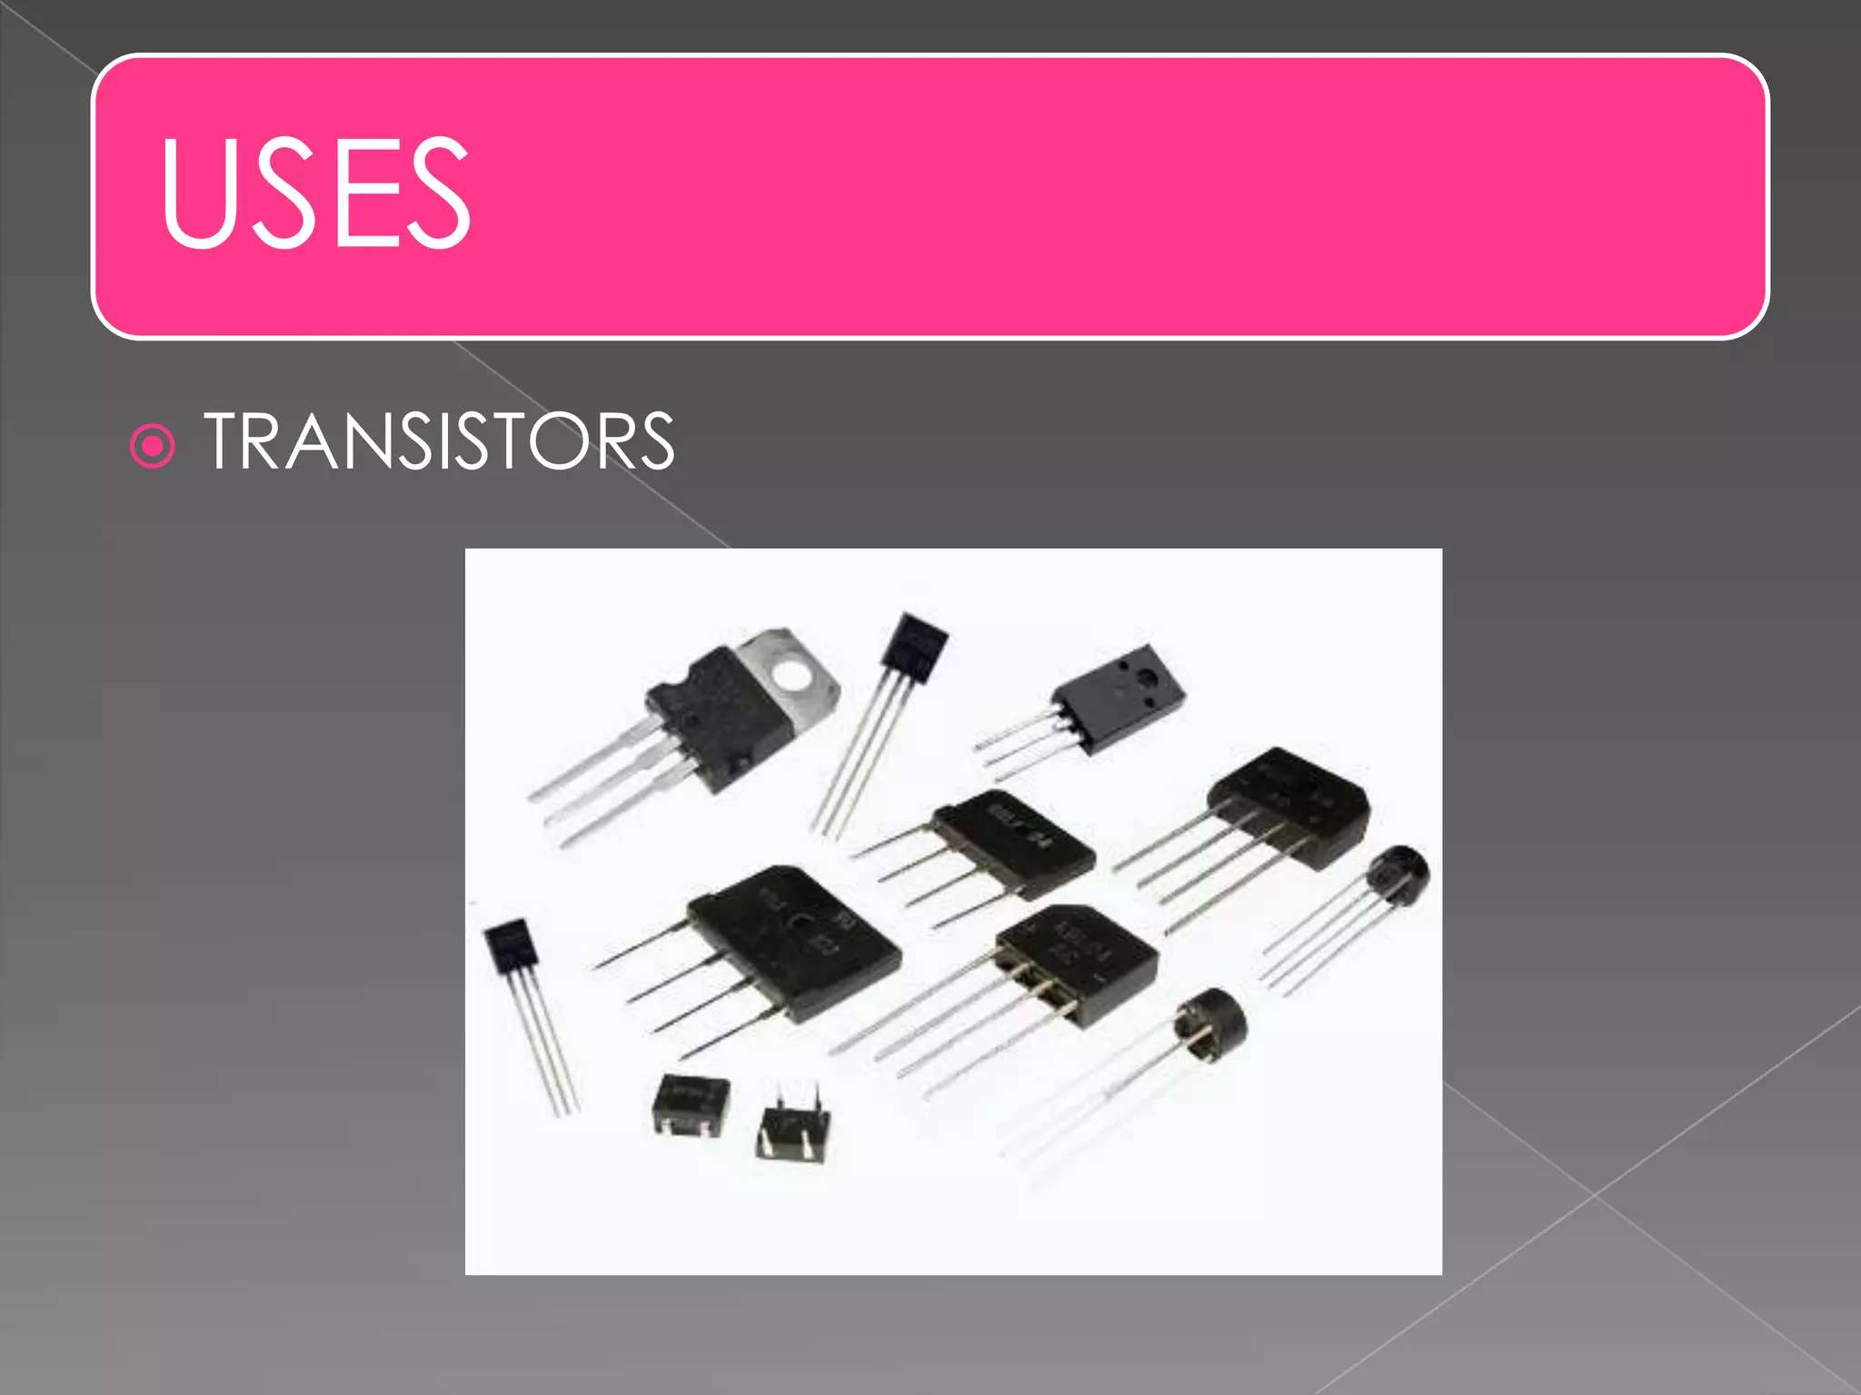


Slide 13
🔹 Q1. MCQ
What is the anode material used in a Nickel-Cadmium battery? a) Nickel(II) oxide-hydroxide b) Cadmium c) Zinc d) Graphite
✅ Correct Answer: b) Cadmium
Q&A
🔹 Q2. MCQ
Which of the following is a major disadvantage of Ni-Cd batteries? a) High cost b) Memory effect c) Non-rechargeable d) Low voltage output
✅ Correct Answer: b) Memory effect
🔹 Q3. Short Answer
Write the overall cell reaction for a Nickel-Cadmium battery.
✅ Answer: 2NiO(OH) + Cd + 2H₂O → 2Ni(OH)₂ + Cd(OH)₂
🔹 Q4. MCQ
The electrolyte used in a Ni-Cd battery is: a) Sulfuric acid b) Potassium hydroxide c) Sodium chloride d) Ammonium sulfate
✅ Correct Answer: b) Potassium hydroxide (KOH)
🔹 Q5. Short Answer
Mention two applications of Nickel-Cadmium batteries.
✅ Answer:
Emergency lighting systems
Cordless power tools (Also used in portable electronic equipment, aircraft starters, etc.)

Slide 14
📚 Key Takeaways:
Ni-Cd batteries are rechargeable secondary cells with good cycle life and robust performance.
The anode is cadmium (Cd) and the cathode is nickel(III) oxide-hydroxide (NiO(OH)).
The electrolyte is typically potassium hydroxide (KOH), which is not consumed during reaction.
They exhibit a memory effect, reducing capacity if recharged before complete discharge.
Ni-Cd batteries have a nominal voltage of 1.2 V per cell.
Common applications include cordless tools, emergency lighting, and aviation electronics.
Although durable, cadmium is toxic; hence environmental handling and disposal regulations apply.

Slide 15
📚 Textbook References
Author(s) | Title of Book | Publisher | Relevant Chapters/Pages
K.L. Kapoor | Electrochemistry and Solutions (Vol. 3) | Macmillan India | Chapter 5: Secondary Batteries, pp. 130–135
Bahl & Tuli | Essentials of Physical Chemistry | S. Chand Publishing | Ch. 9 – Batteries, pp. 680–685
Gurdeep Raj | Advanced Physical Chemistry | Goel Publishing House | Section on Secondary Cells
Sharma & Kaur | Physical Chemistry | Krishna Prakashan | Chapter on Batteries
P.W. Atkins & Julio de Paula | Physical Chemistry | Oxford University Press | Ch. 19 – Electrochemistry, pp. 670–692

